Slide 1
PartsTracker
Rudi Grobler

Slide 2
Before you start
Make sure the following is installed:
Git
Docker
IDE – Either VS Code or VS 2022

Slide 3
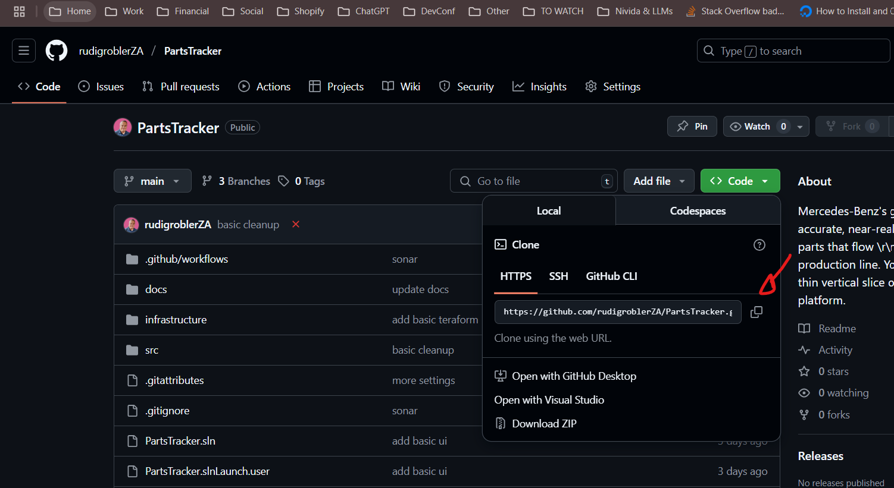
Getting Started
Go to GitHub and clone the repository
https://github.com/rudigroblerZA/PartsTracker
git clone https://github.com/rudigroblerZA/PartsTracker.git
cd .\PartsTracker\

Slide 4
Build & Run
First pull and build all the docker images
Once build, you can run it
docker-compose build
docker-compose pull
docker-compose up

Slide 5
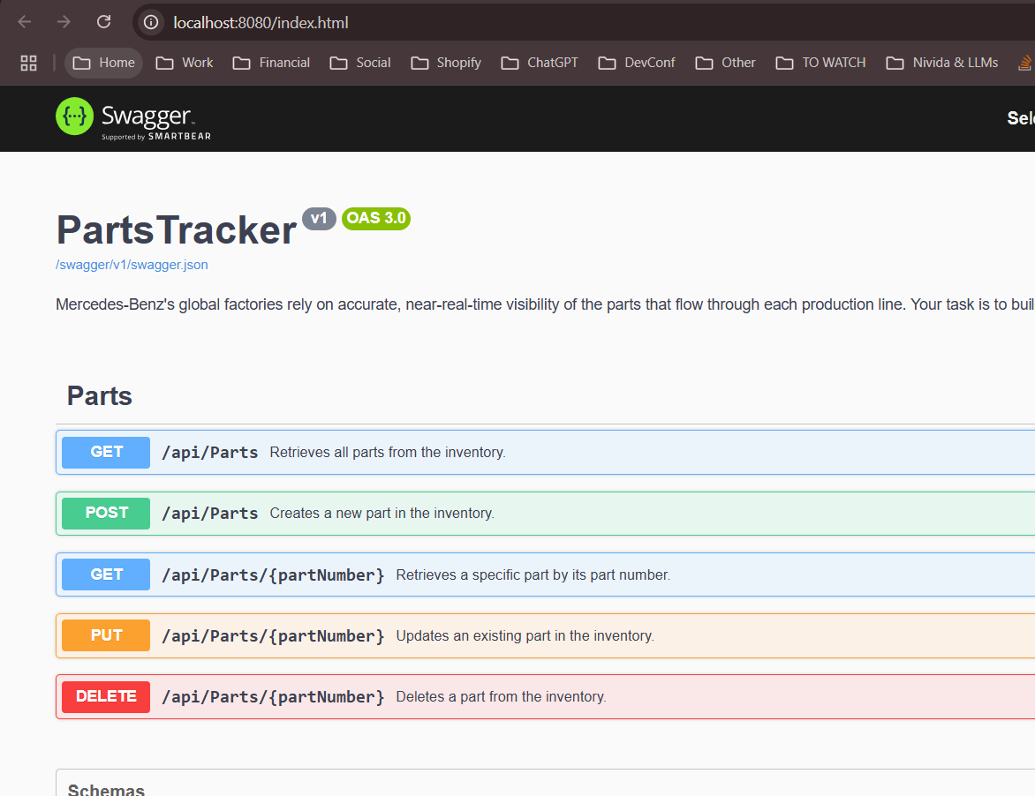
WebApi
Navigate to http://localhost:8080

Slide 6
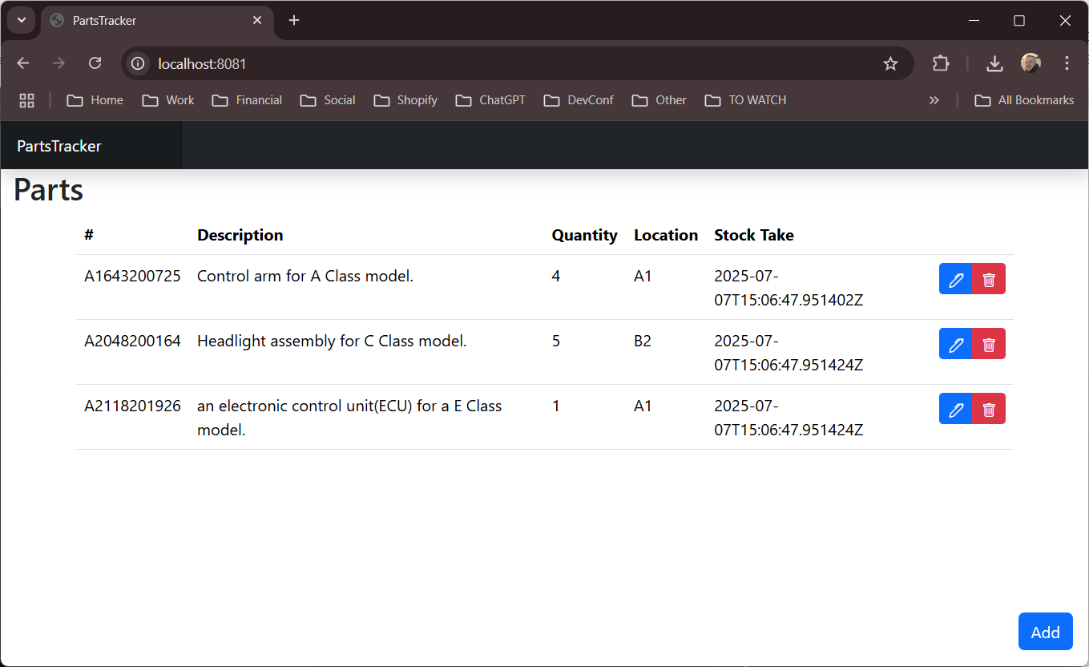
UI
Navigate to http://localhost:8081

Slide 7
Build and Test via CLI
You can also build and test the solution via CLI
dotnet build ./PartsTracker.sln
dotnet test ./PartsTracker.sln

Slide 8
DEMO

